Slide 1
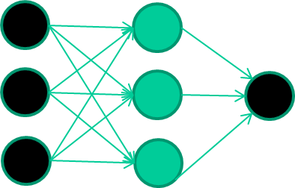
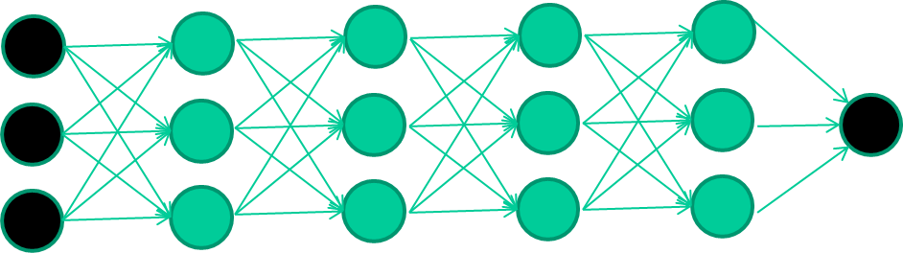

Deep Neural Networks
A deep neural network (DNN) is an artificial neural network (ANN) with multiple hidden layers of units between the input and output layers.
Deep learning is a branch of machine learning using DNNs.
A fast-growing field, and new architectures or algorithms appear every few weeks.

Slide 2

Convolutional Neural Networks
Convolutional Neural Networks are extensions of multilayer neural networks.
CNNs have shown superior results in both image and speech recognition tasks - matching or exceeding human performance in some domains.
CNNs are used by most of banks to recognise hand-written numbers on checks.

Slide 3
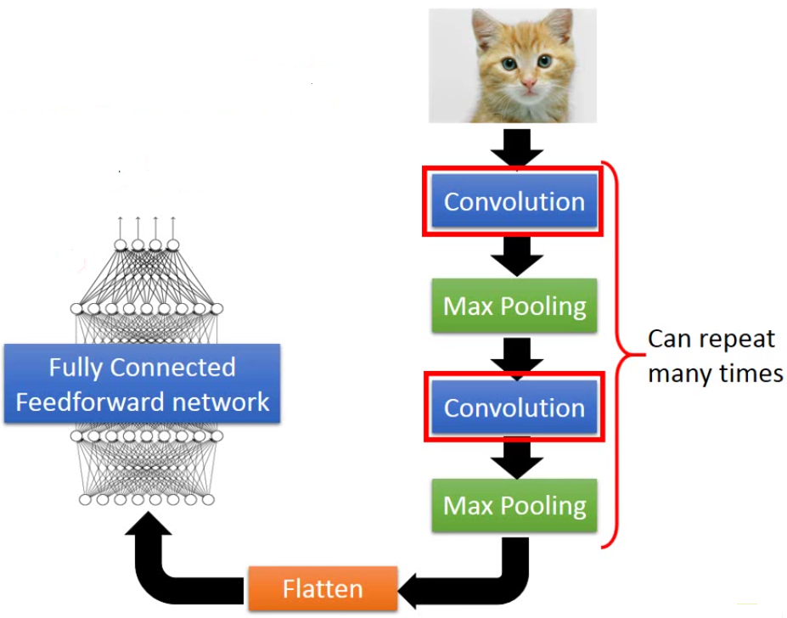
A Convolutional Neural Network

Slide 4
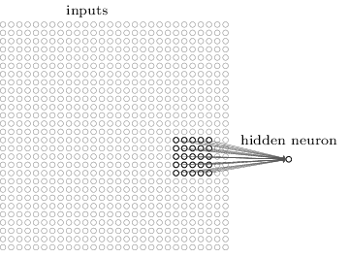
Convolutional Layers
Convolutional layers are the core building block of a CNN.
The primary purpose for a convolutional layer is to detect features such as edges, lines, and other visual elements.
Each neuron in the convolutional layer is connected to a small region of the inputs.

Slide 5
Max-Pool Layers
Max-pool layers are usually used immediately after convolutional layers.
Using max-pooling is to simplify the information in the output from the previous convolutional layer.
The intuition is that once a visual feature has been detected, its exact location is not as important as its rough location relative to other features.

